Slide 1
Create
Read
Update
Delete
Michal Špaček https://www.michalspacek.cz

Slide 2
Recap – Hardwares db servers (boxes)
Box 1
Box 2
Box 3
Box 4

Slide 3
Recap – Software db servers
MySQL 1
PostgreSQL
MSSQL
XYZ
Oracle
MySQL
2
MySQL
ABC

Slide 4
Recap – Databases (schemas)
A
B
Proj1
P6
Proj2
Proj3
Shop
P3
ABC

Slide 5
Recap – Tables
A
B
Users
Addresses
Orders
Products
Stuff
MySQL 1

Slide 6
Recap – Rows and Columns
A
First | Last | City | Country
John | Foo | NY | US
M | S | Praha | CZ
Users
Orders
Stuff

Slide 7
Database management tool
phpMyAdmin https://www.phpmyadmin.net/
Adminer https://www.adminer.org/

Slide 8
MySQL
SQL – Structured Query Language
Compatible MySQL forks
MariaDB
Percona
AWS Aurora
Other well-known servers
PostgreSQL
Microsoft SQL server
Oracle Database

Slide 9
MySQL credentials (XAMPP default)
Server: localhost User: root
Password: <none>
(Database: …)

Slide 10
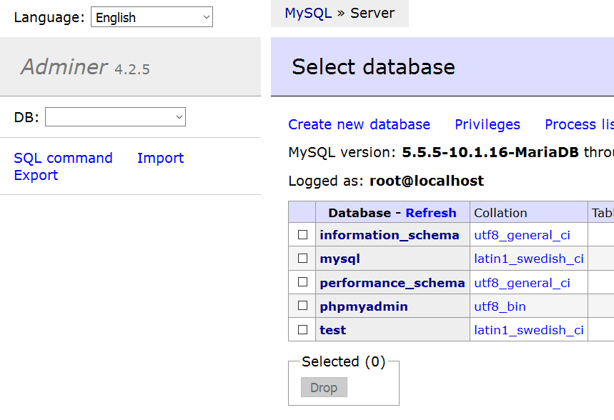

Slide 11
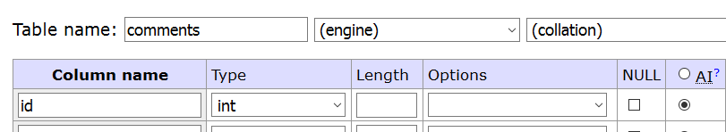
Have column id AUTOINCREMENT in every table

Slide 12
Data types
Numbers INT
Strings VARCHAR(maxlength)
Dates DATE or DATETIME
NULL = nothing, not even empty
https://dev.mysql.com/doc/en/data-types.html

Slide 13
Create – INSERT
INSERT INTO table (name, city) VALUES ('John', 'Prague');
INSERT INTO table (name, city) VALUES ('Jack', 'NYC');
INSERT INTO table (name, price) VALUES ('submarine', 123456789);
INSERT INTO table (name, price) VALUES ('pizza', 1000000);

Slide 14
Read – SELECT
SELECT name, city FROM table;
(SELECT * FROM table;)
SELECT name, city FROM table WHERE name = 'Jack';
SELECT name FROM table WHERE name = 'Jack' AND city = 'NYC';

Slide 15
Update – UPDATE
UPDATE table SET price = 12345 WHERE name = 'pizza';
UPDATE table SET price = 12345, name = 'capri' WHERE name = 'pizza';

Slide 16
Update – UPDATE
UPDATE table SET price = 12345;
BOOM YOU'RE FUCKED

Slide 17
Delete – DELETE
(DELETE FROM table WHERE name = 'pizza';)
DELETE FROM table WHERE id = 123;

Slide 18
Delete – DELETE
DELETE FROM table;
BOOM
YOU'RE FUCKED
HARD

Slide 19
Portfolio work
Good luck!

